Slide 1
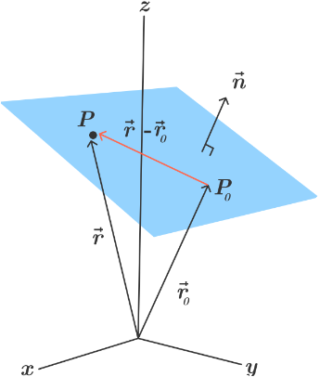
Planes in 3D Space
Consider the plane containing the point
and normal vector n = < a, b, c > perpendicular to the plane.

Slide 2
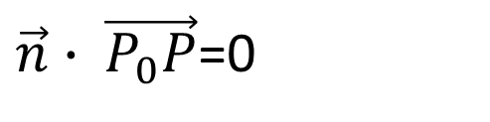
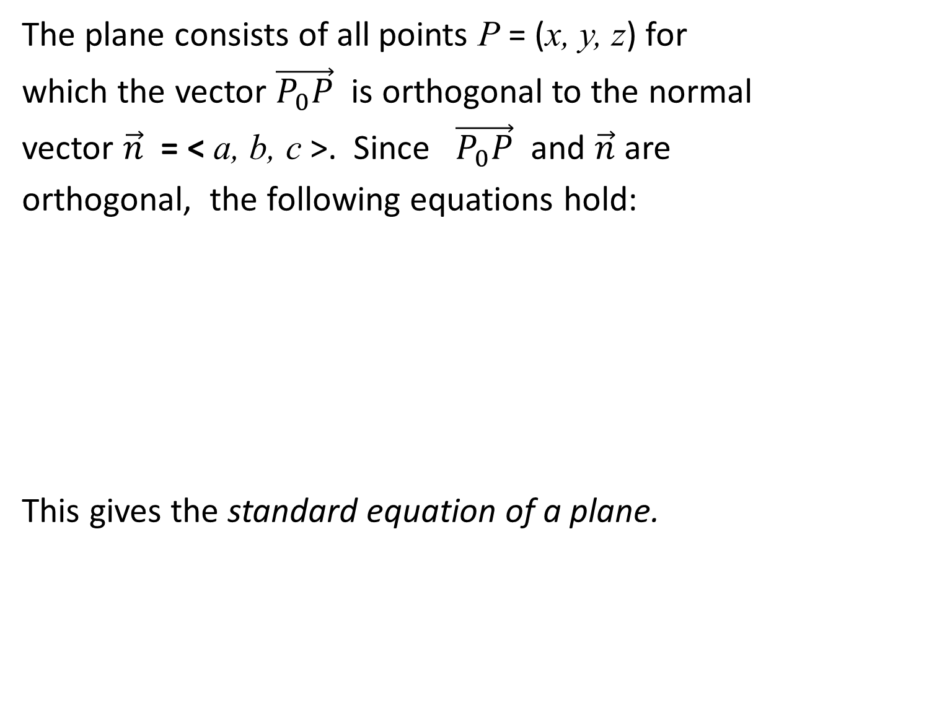
The plane consists of all points P = (x, y, z) for
which the vector $\vec{P_{0}P}$ is orthogonal to the normal
vector $\vec{n}$ = < a, b, c >. Since $\vec{P_{0}P}$ and $\vec{n}$ are
orthogonal, the following equations hold:
This gives the standard equation of a plane.
$\vec{n}∙ \vec{P_{0}P}$=0

Slide 3
If we expand this equation we obtain the following
equation:
Setting gives the general form
of the equation of a plane in 3D space
We summarize these results as follows.

Slide 4
Standard and General Equations of a Plane in 3D
space
The standard equation of a plane in 3D space has the
form
where is a point on the plane and n = < a, b, c >
is a vector normal (orthogonal to the plane). If this
equation is expanded, we obtain the general equation of
a plane of the form

Slide 5
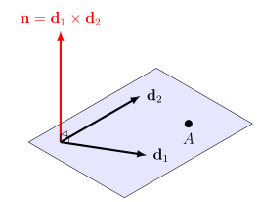
Note1 To write the equation of a plane in 3D
space, we need a point on the plane and a vector
normal (orthogonal) to the plane.
Note2 A single vector parallel to a plane is not enough to convey the ‘direction’ of the plane.
Note3 In a three-dimensional space, a plane can be defined by three points it contains, as long as those points are not on the same line

Slide 6
Intersecting Planes
Suppose we are given two intersecting planes
with angle between them.
Plane 1
Plane 2

Slide 7
Let and be normal vectors to these
planes. Then
Thus, two planes are
1. Perpendicular if , which implies .
2. Parallel if , where c is a scalar.

Slide 8
Notes
Given the general equation of a plane
the normal vector is n = < a, b, c >.
2. The intersection of two planes is a line.

Slide 9
Distance Between Points and a Plane
Suppose we are given a point Q not in a plane
and a point P on the plane and our goal is to find
the shortest distance between the point Q and the
plane.
Q
P

Slide 10
By projecting the vector onto the normal vector n (calculating the scalar projection we can find the distance D.
Q
P

Slide 11
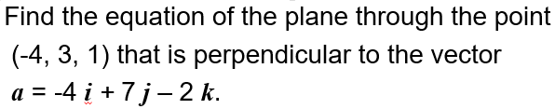

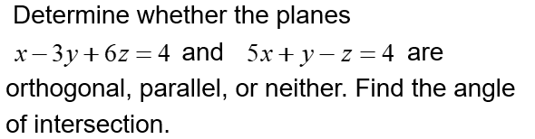
Practice 1
Determine the distance between the point P = (1, 2, 5) and the plane π: 3x + 4y + z + 7 = 0

Slide 12
Equation of line in space
Consider the line L through the point that is parallel to the
vector v = < a, b, c >.
L
v = < a, b, c >
y
x

Slide 13
The line L consists of all points Q = (x, y, z) for
which the vector is parallel to v.
Now,
Since is parallel to v = < a, b, c > ,
= t v
where t is a scalar. Thus

Slide 14
= t v = < t a, t b, t c >
Rewriting this equation gives
Solving for the vector gives
Setting r = , , and
v = < a, b, c >, we get the following vector
equation of a line.

Slide 15
Vector Equation of a Line in 3D Space
The vector equation of a line in 3D space is given
by the equation
t v
where = is a vector whose
components are made of the point
on the line L and v = < a, b, c > are components
of a vector that is parallel to the line L.

Slide 16
Parametric Equations of a Line in 3D Space
The parametric equations of a line L in 3D space
are given by
where is a point passing through the
line and v = < a, b, c > is a vector that the line is
parallel to. The vector v = < a, b, c > is called the
direction vector for the line L and its components
a, b, and c are called the direction numbers.

Slide 17
Symmetric Equations of a Line in 3D Space
The symmetric equations of a line L in 3D space
are given by
Where is a point passing through the
line and v = < a, b, c > is a vector that the line is
parallel to. The vector v = < a, b, c > is called the
direction vector for the line L and its components
a, b, and c are called the direction numbers.

Slide 18
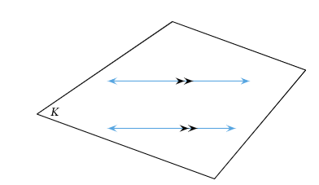
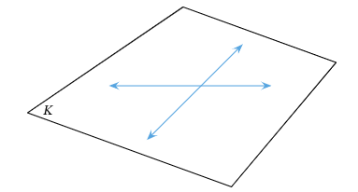
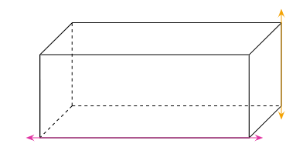
The Relationship between Two Lines in Space
parallel
intersect
A pair of lines that neither intersect nor are parallel to one another are said to be skew

Slide 19
Note1. To write the equation of a line in 3D
space, we need a point on the line and a parallel
vector to the line.
Note2. Two distinct points in the space determine a unique line passing through both of them .
Note3. A line can be determined as an intersection of two planes.
Note4. The equations of lines in 3D space are not unique.

Slide 20
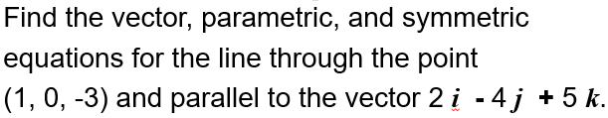

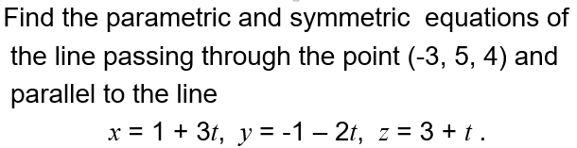
Practice 2

Slide 21
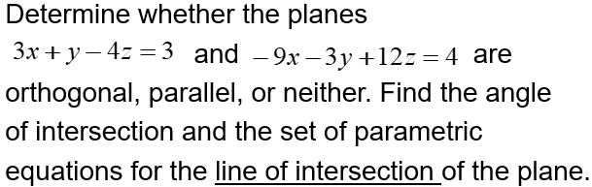
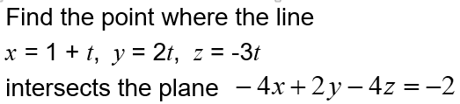
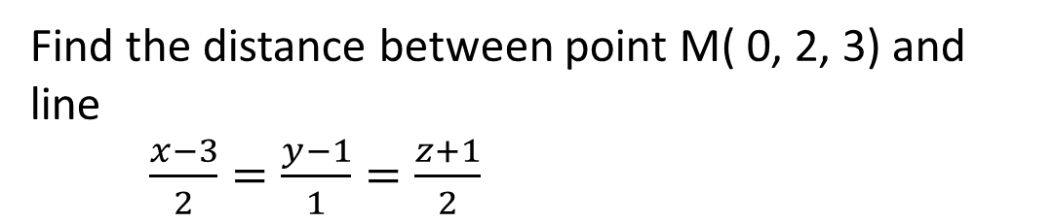
Practice 3
Find the distance between point M( 0, 2, 3) and line
$\frac{x−3}{2}=\frac{y−1}{1}=\frac{z+1}{2}$

Slide 22
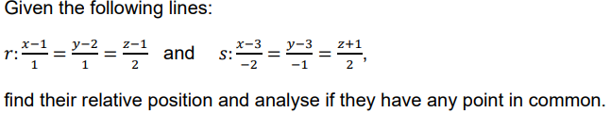

Practice 4

Slide 23

Practice 5

